Slide 1

VISHNU DESHPANDE
Data Excel File Docs File

Slide 2
Introduction
This presentation will help us to understand the trends in Restaurants over different countries which will help us to take decisions upon opening of new restaurants
For this, we would be using the data of 9 Years from 2010-2018
We would be comparing Number Of Restaurants, Ratings, Expenditures, Cuisines etc. in each country to get the valuable insights.

Slide 3
SELECTION OF COUNTRIES
We will try to find suitable countries to open our new Restaurant on the basis of :
Number of Restaurants already present in countries
Expenditure
Ratings of Restaurants
Cuisines with top ratings
Online delivery and Table booking

Slide 4
ANALYSIS – OPENING NEW RESTAURANT
Analyzing Countries with less competition.
States and Cities for opening new restaurant.
Rating – in the suggested country.
Total expenditure on food – in the suggested country.
Competitors.
Cuisines.
Online delivery / table booking.
Restaurants in different price range.
Dashboard.

Slide 5




COUNTRIES
The selection of countries has been done on the basis of two factor:
Less Competition
The ratings are average in the countries – the rating has been taken into consideration as this indicates the people are not satisfied with the type of restaurant that are there.

Slide 6
Country – Selected Cities
CANADA
PHILIPPINES
QATAR
SINGAPORE
SRI LANKA
YORKTON
SANTA ROSE
DOHA
SINGAPORE
COLOMBO

Slide 7
AVERAGE RATING OF RESTAURANTS IN SELECTED COUNTRIES
Row Labels | Average of Rating
Canada | 3.575
Philippines | 4.468181818
Qatar | 4.06
Singapore | 3.575
Sri Lanka | 3.87
Grand Total | 3.984883721
The ratings in the selected countries are in the range 3.58 to 4.47. The average of ratings are giving insights that people are not fully satisfied with some restaurants.
And hence its an opportunity for us to attract the people by providing the best of food and services.

Slide 8
Expenditure on Food
Row Labels | Average of Average_Cost_for_two
Canada | 36.25
Philippines | 1606.818182
Qatar | 223.75
Singapore | 155.75
Sri Lanka | 2375
Grand Total | 1053.313953

Slide 9
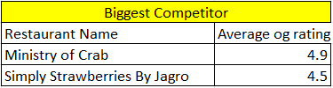

FEW RESTAURANT NAMES - BIGGEST COMPETITORS
RESTAURANTS WITH LOW RATING

Slide 10
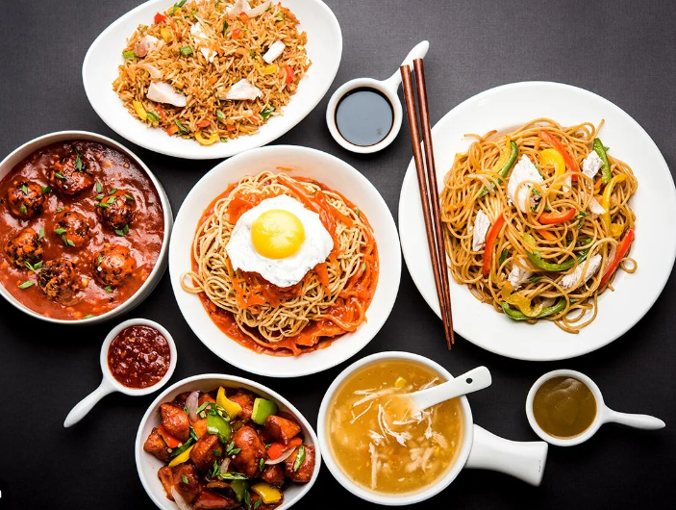
CUISINES with TOP RATINGS
These are the cuisines in the suggested four countries with high number of ratings.
These are some cuisines in all the four countries. It includes local food of that country and some other cuisines.
Top preference cuisines are seafood and Italian.
CUISINES:-
American, Asian, Seafood, Italian, Filipino, Japanese, Korean, Sushi, Steak, European, café, Pizza, Indian, Mediterranean.

Slide 11
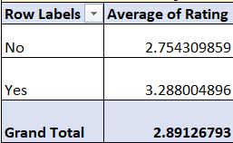
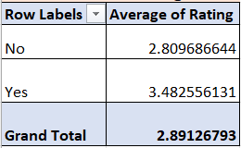
DELIVERY- ANALYSIS
ONLINE-DELIVERY
TABLE - BOOKING

Slide 12
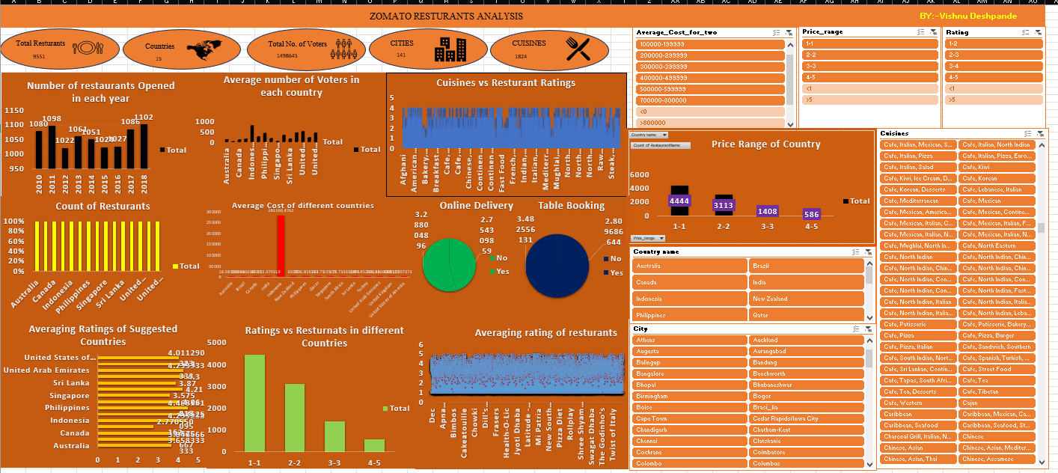
DASHBOARD

